Slide 1
Student Record system

Slide 2
SOFTWARE DEVELOPER
TEAM MEMBER
SHIKHAR GUPTA

Slide 3
AIM
To develop a software for Recording a Information of a Student.
In order to FULFILL the needs of an end Record user by providing various ways to perform Student tasks.

Slide 4
ABOUT PROJECT
The Student Record System is a software for maintain Record of student in a School.
The SYSTEM provides the access to the Student or to create an record, modify/delete in his id.
This all view present the Student record system.

Slide 5
Requirement
User requirement
System requirement

Slide 6
User Requirement
BASIC KNOWLEDGE TO COMPILE PROJECT ON UNIX ENVIOURNMENT

Slide 7
System Requirement
SOFTWARE REQUIREMENT
FRONT END- C
OS – UNIX/LINUX

Slide 8
Introduction The project “Student record System” is an application to automate the process of Record of a “Student”. This web based application is designed considering the chain of departmental store which is located in various cities. This application also administrates its users and Student.

Slide 9
OBJECTIVE * Add and maintain record of available products. *Add and maintain Student details. *Add and maintain Record of new Student. *Provides a convenient solution of Filling record . *Make an easy to use enviroment for users and Student.

Slide 10
Output for Creating An Record
USER
NEW RECORD
NEW FORM
DB
VERIFY
REJECT
CREATE RECORD
CREATED

Slide 11
USER
DIAGRAM FOR OUTPUT
FEATURE
OUTPUT
FILL THE FORM
DATA BASE
VERIFY
FORM GENERATE

Slide 12
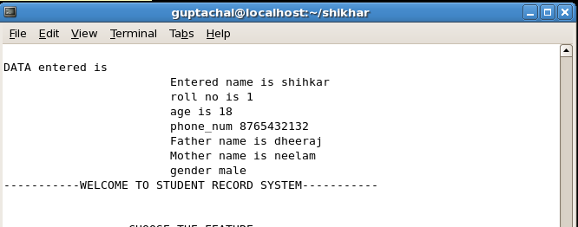
OUTPUT OF GENETARE RECORD

Slide 13
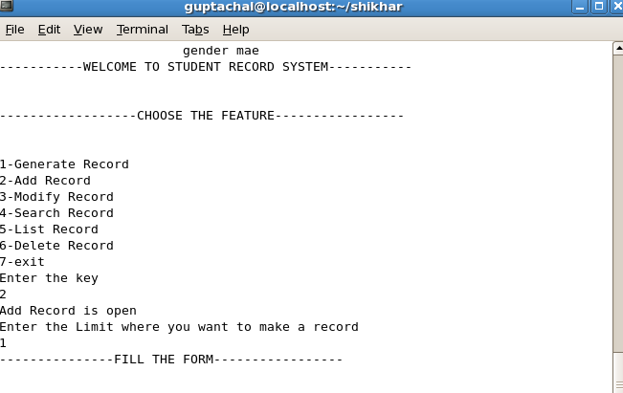
OUTPUT OF ADD RECORD

Slide 14
THANK YOU

